Slide 1


Thrust Mixing, Saturation, and Body-Rate Control for Accurate Aggressive Quadrotor Flight
Matthias Faessler, Davide Falanga, and Davide Scaramuzza
IEEE Robotics and Automation Letters (RA-L)

Slide 2
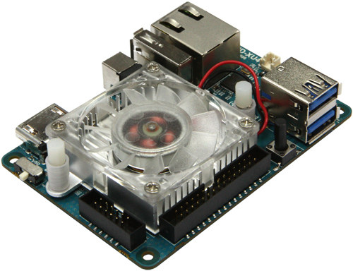
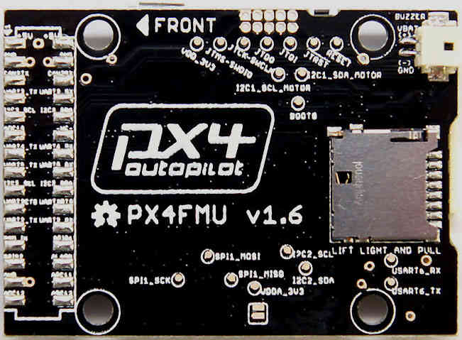
System Overview
High-Level Part
Low Level Part
Position Controller
Body Rate Controller
Mixer
Motors
Body Rates
Collective Thrust
Body Torques
Collective Thrust
Cmds

Slide 3
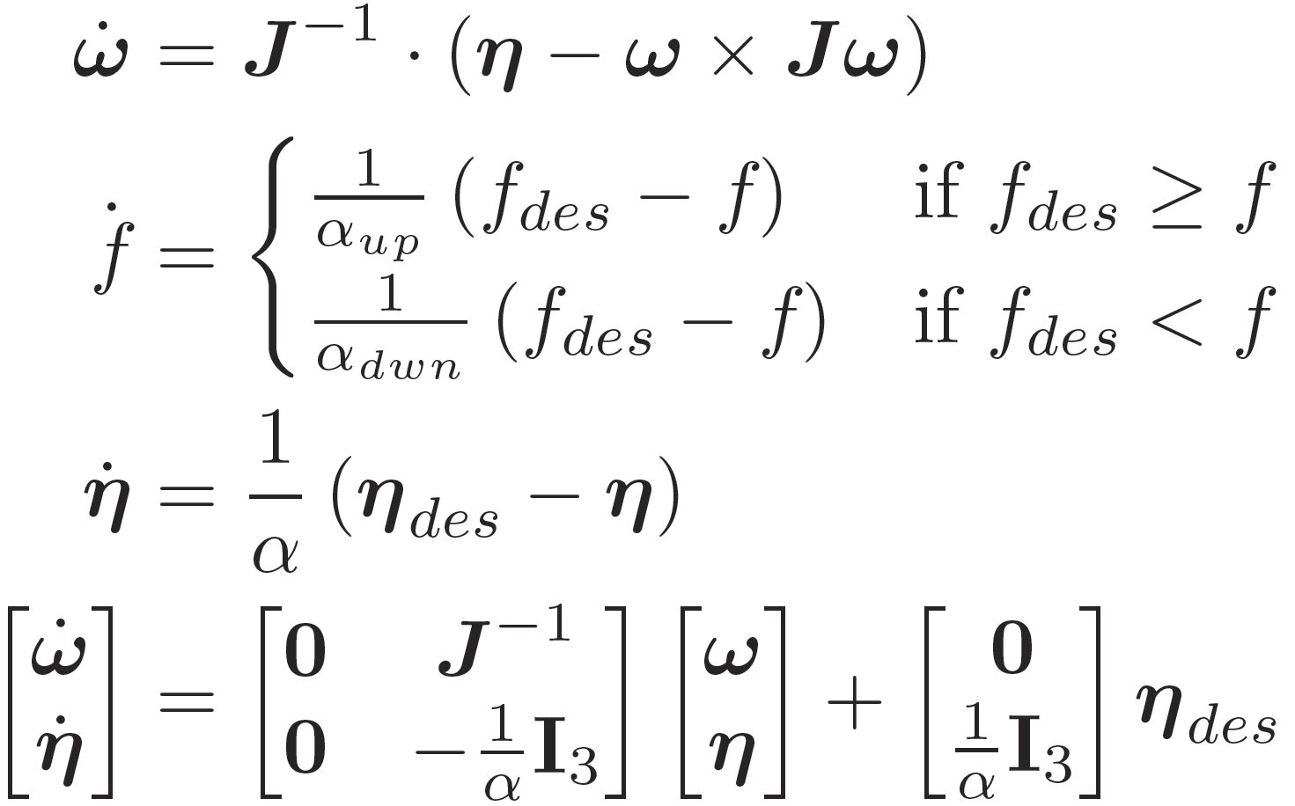
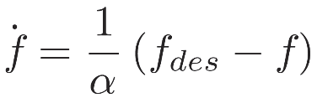
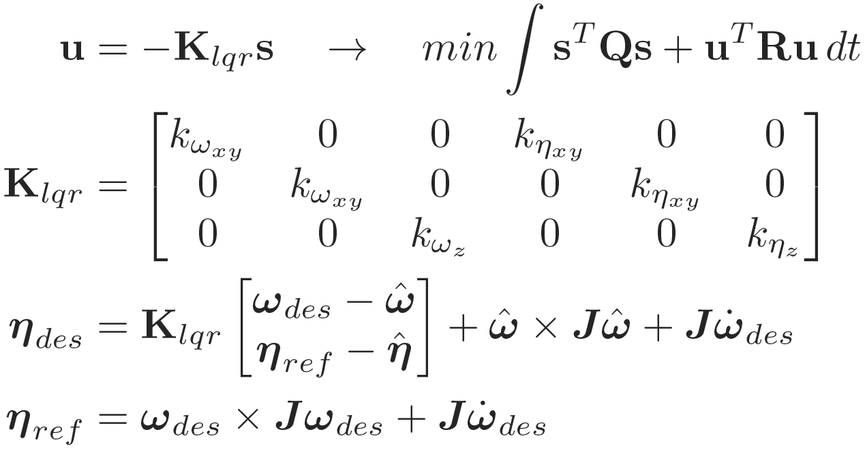
Dynamical System
Body-rate dynamics
Additionally consider single rotor thrust dynamics
Resulting body-torque dynamics
Dynamical system with body rates and body torques as states
Notes:
Proposed controller provides a good tradeoff between trajectory tracking and disturbance rejection performance. Compared to a proportional controller it can almost halve the body-rates tracking error while maintaining the same level of disturbance rejection.

Slide 4
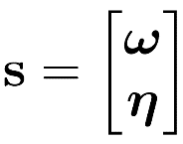
LQR Control Design
Dynamical system
Design infinite horizon LQR controller
Resulting LQR control law with feed forward terms

Slide 5
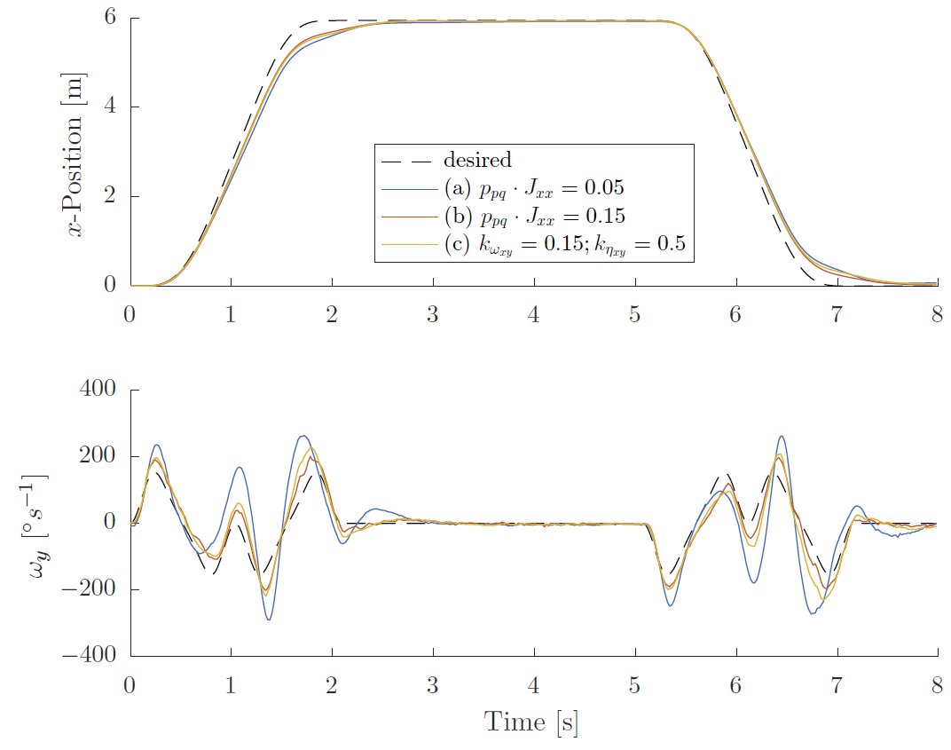
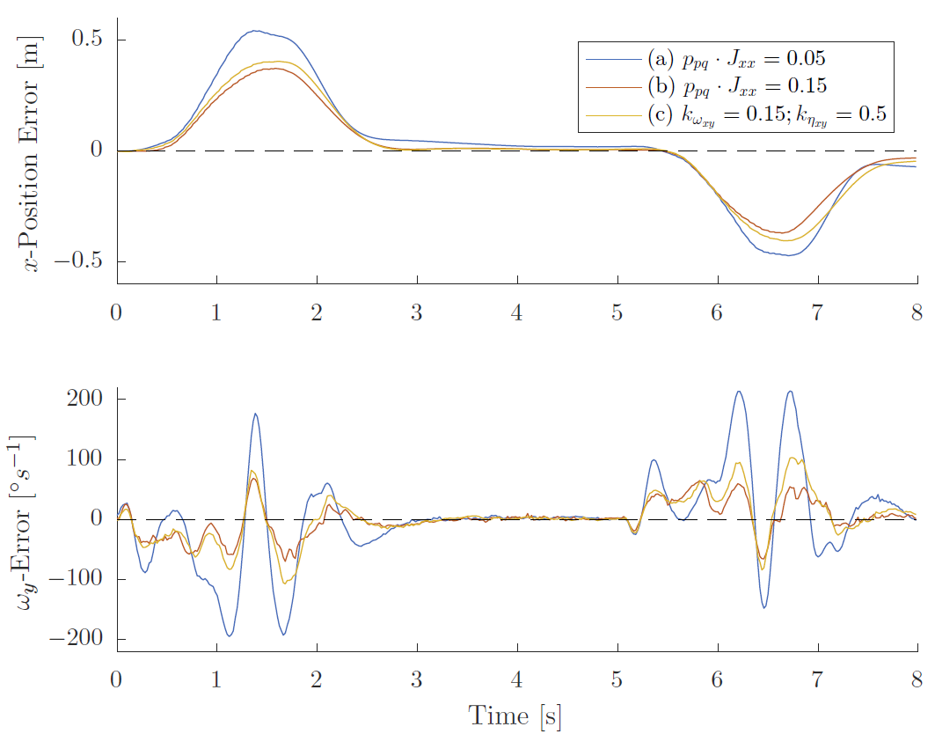

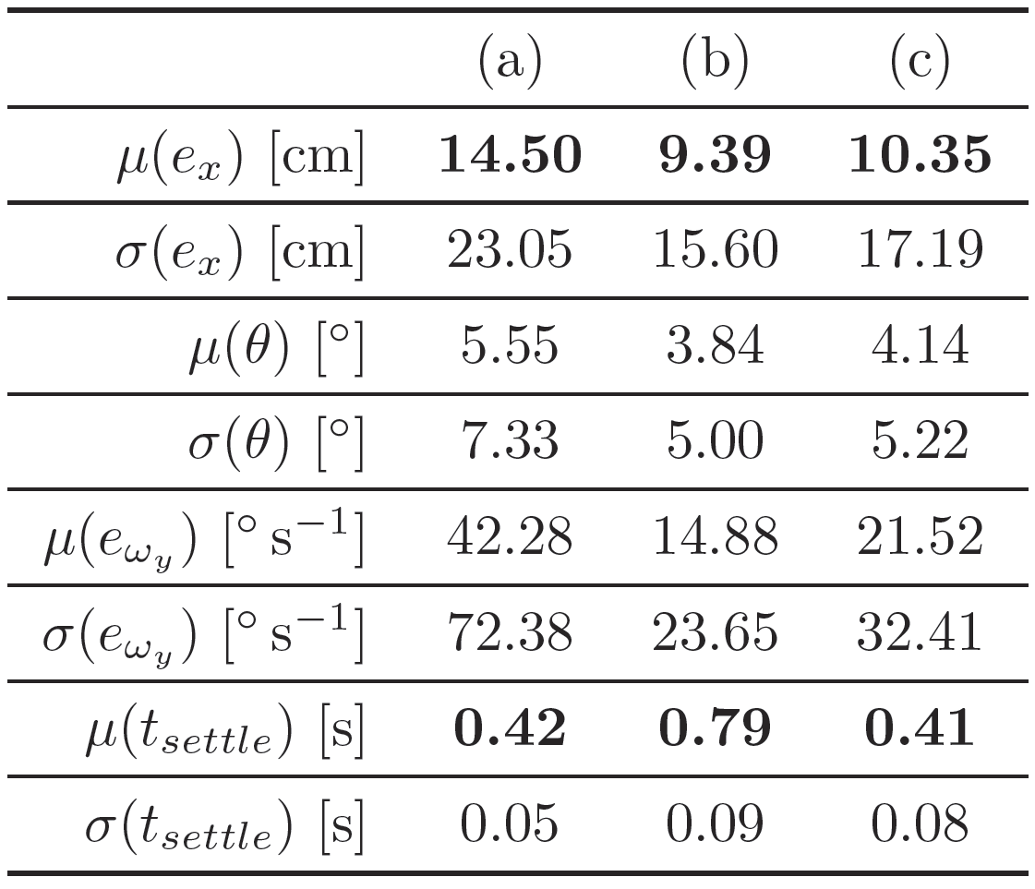
Controller Trajectory Tracking Performance

Slide 6
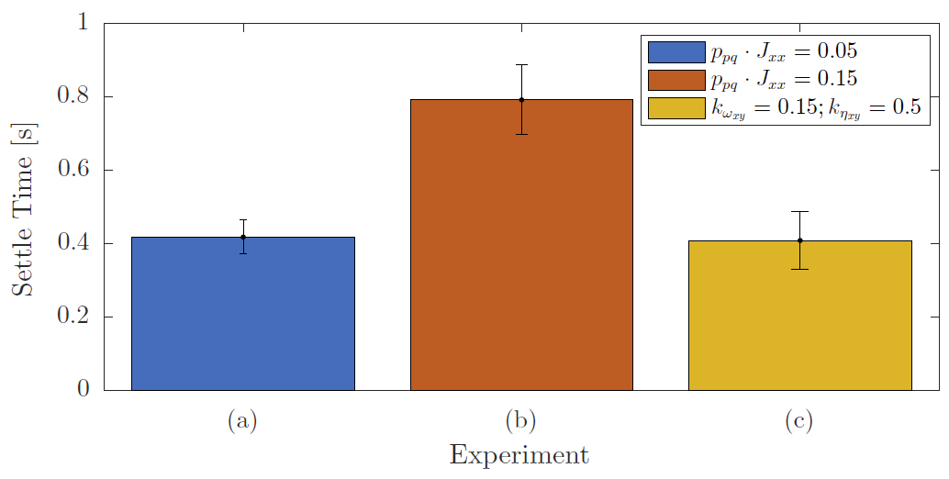
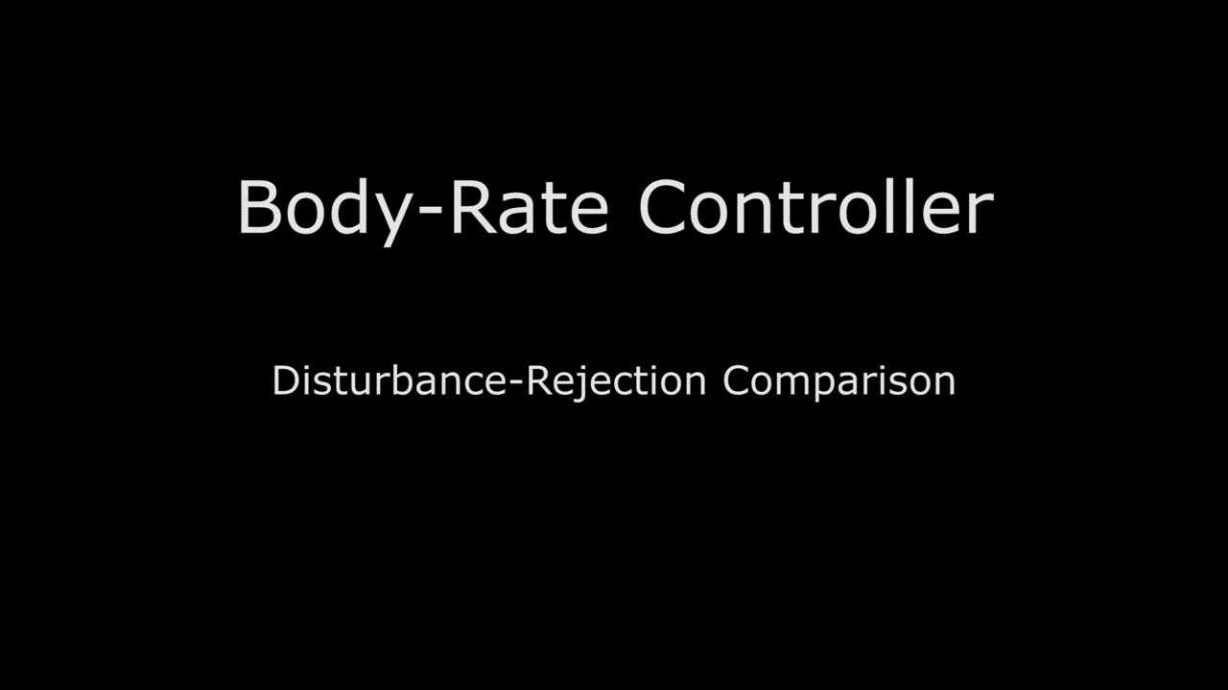
Controller Disturbance Rejection

Slide 7
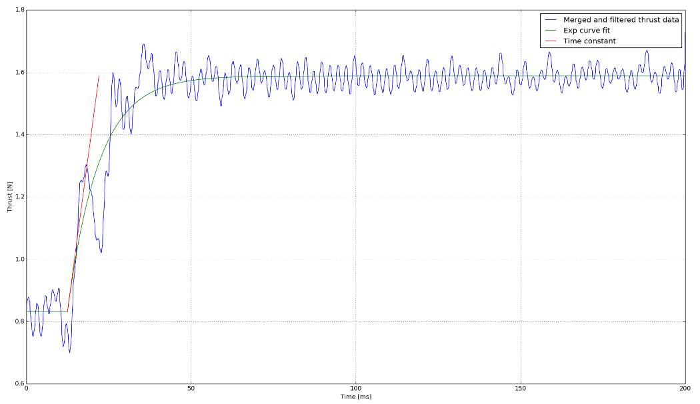
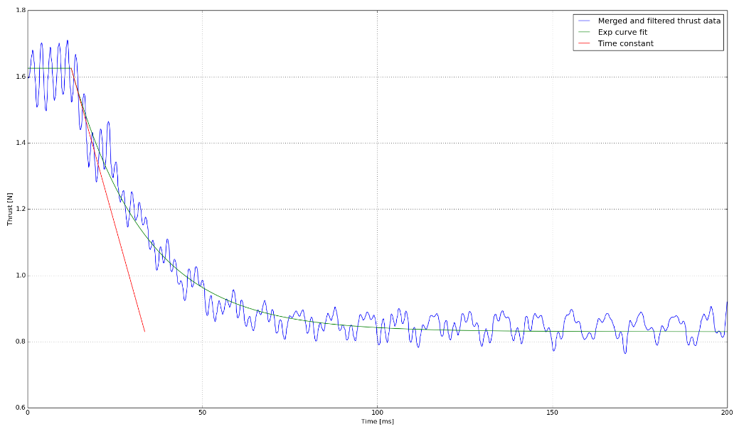
Body Torque Estimation
Integrate first-order thrust dynamics
Load-cell step-input experiments

Slide 8
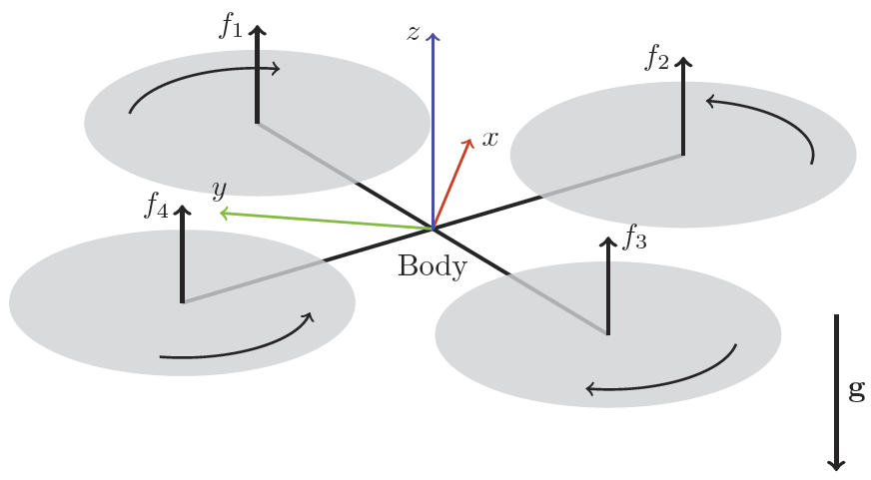
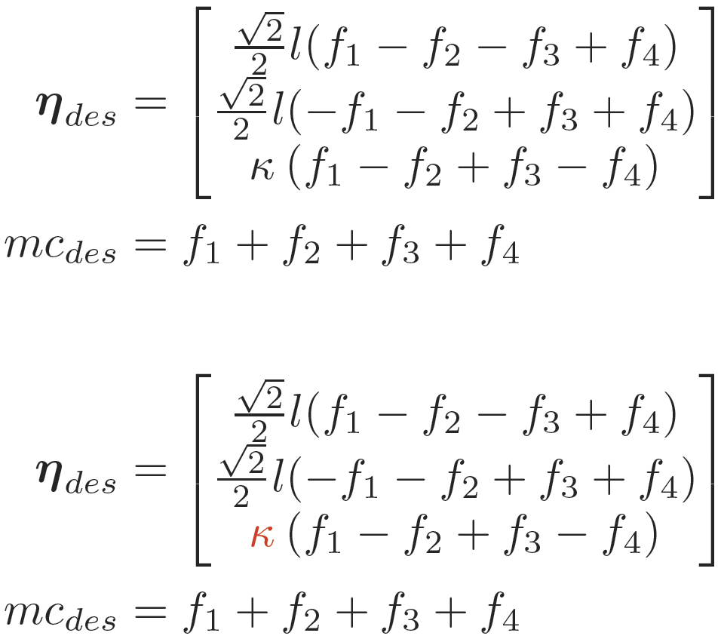
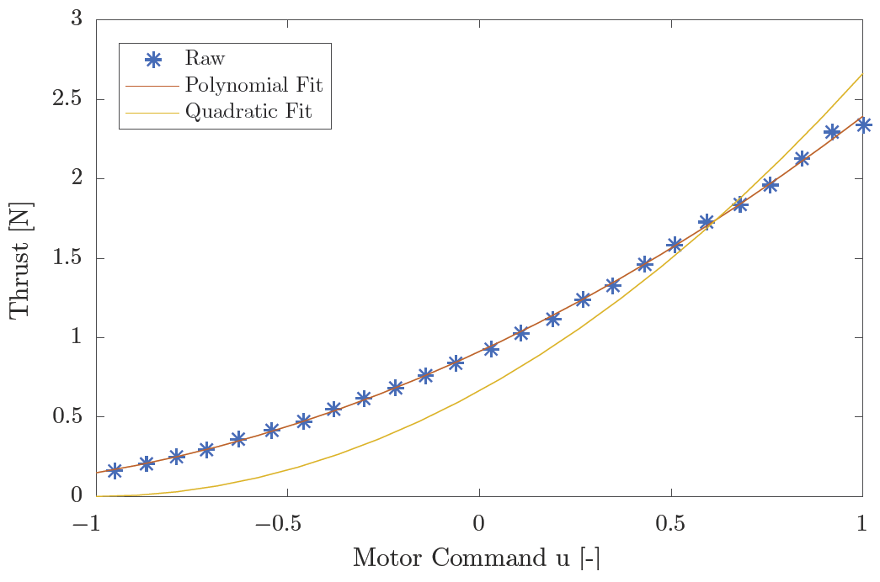
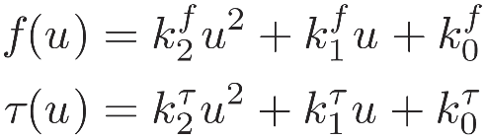
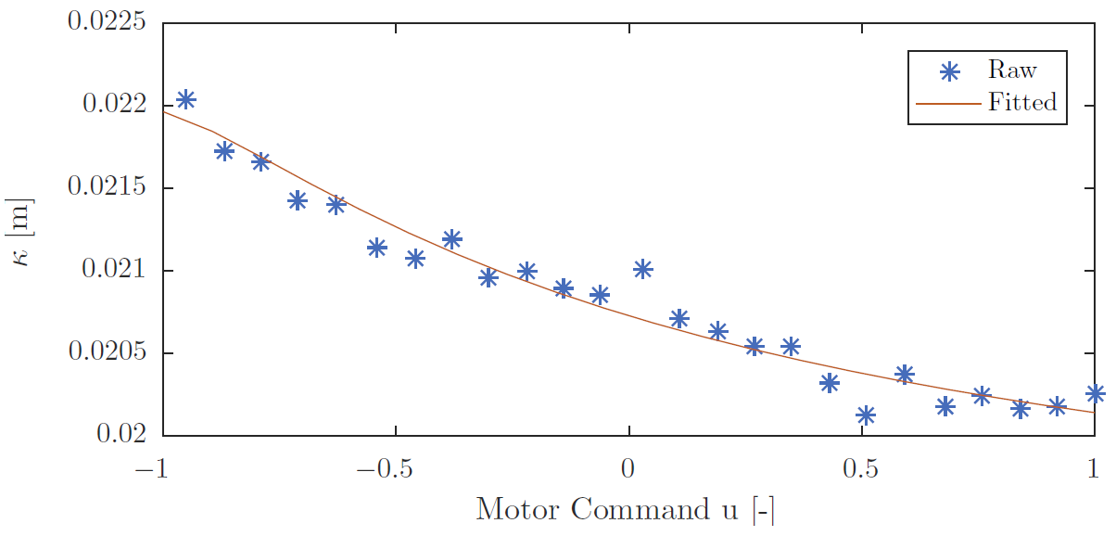
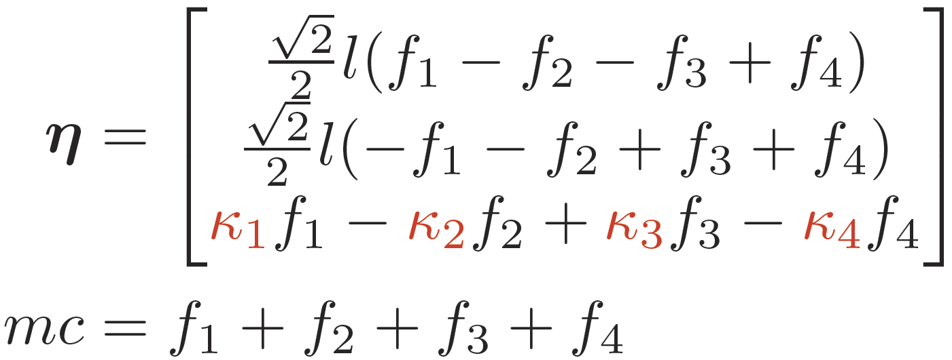

Idea Behind Proposed Thrust Mixing
Thrust mixing means finding $f_{1}$, $f_{2}$, $f_{3}$, $f_{4}$ s.t.
Rotor thrust and drag-torque model
Individual torque to thrust ratio
Notes:
Equalize font size in formulas

Slide 9
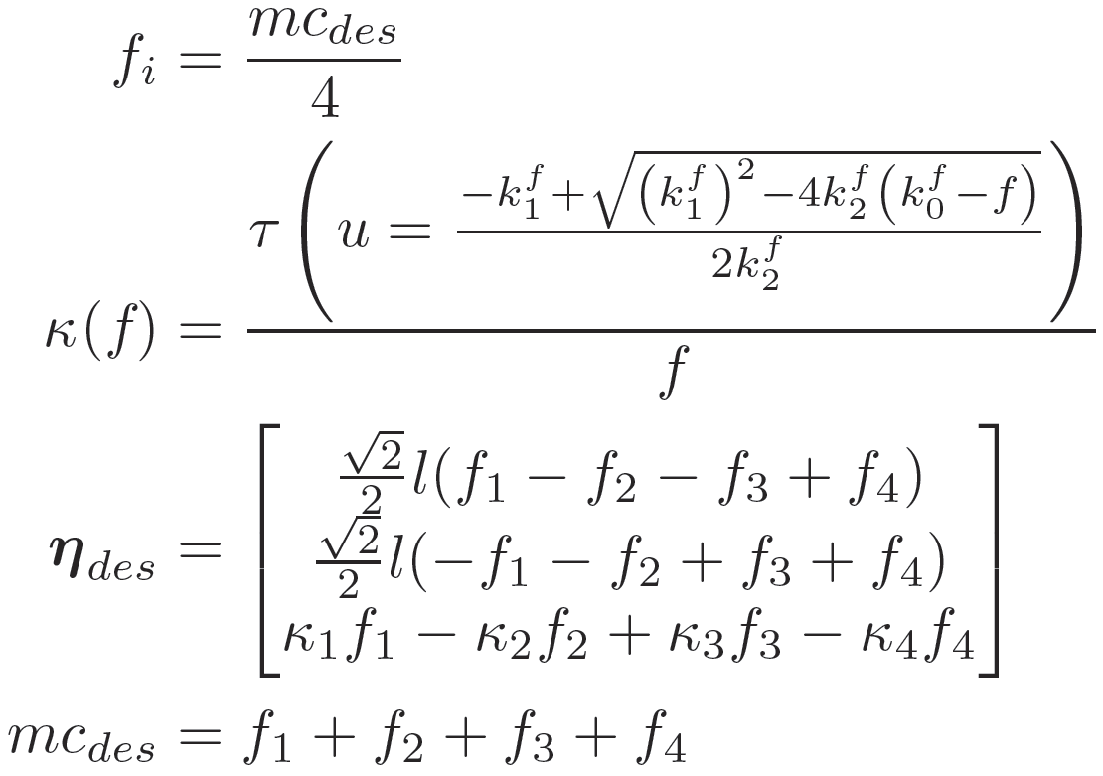
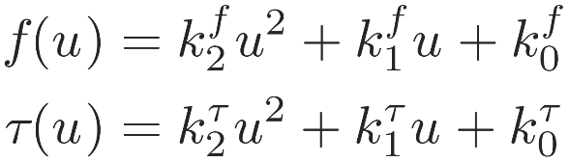
Iterative Thrust Mixing
Initialize iteration
Using rotor thrust and drag torque model
Iterate

Slide 10
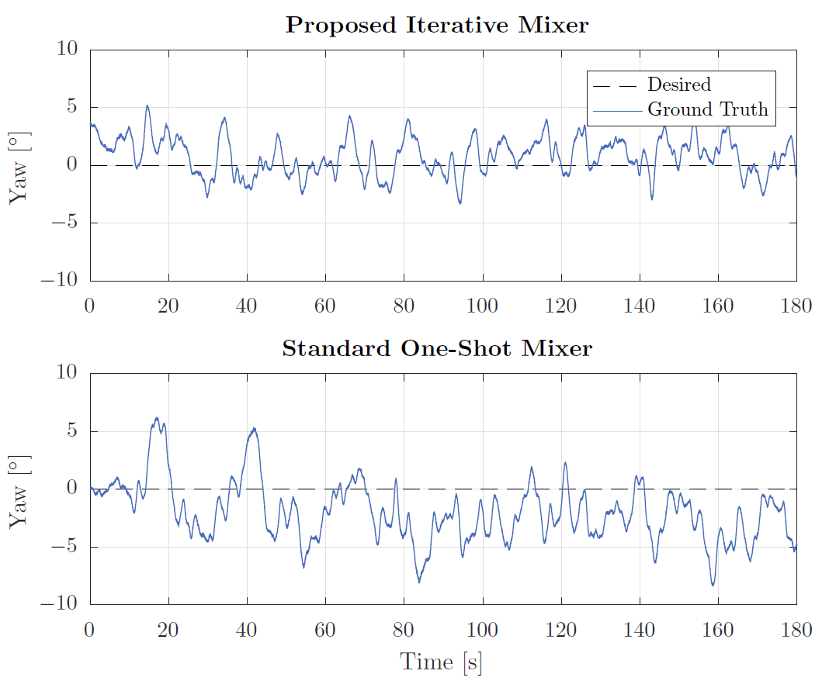
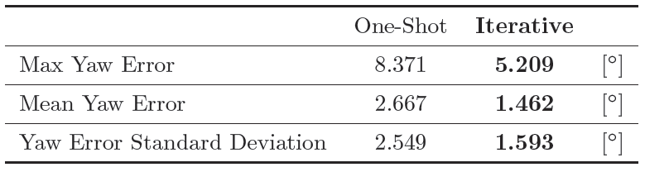
Yaw Control Performance

Slide 11
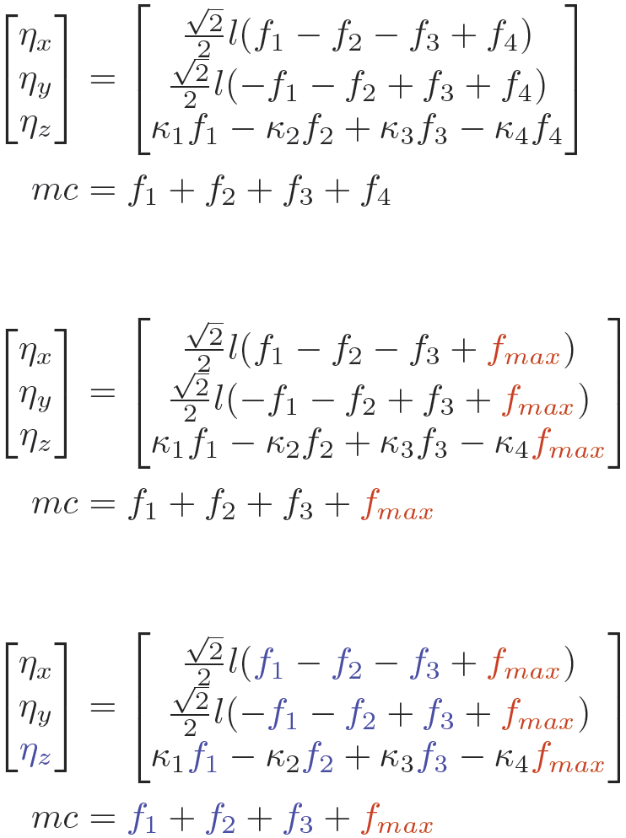
Idea Behind Handling Motor Saturations
Recall thrust mixing
Example: one motor saturates
Proposed prioritizing saturation

Slide 12
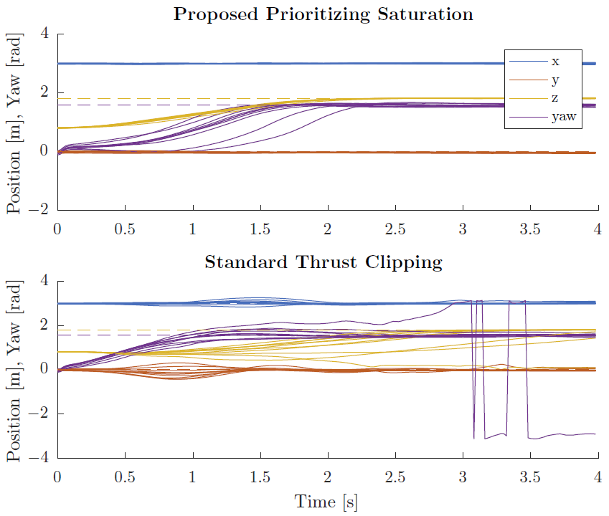
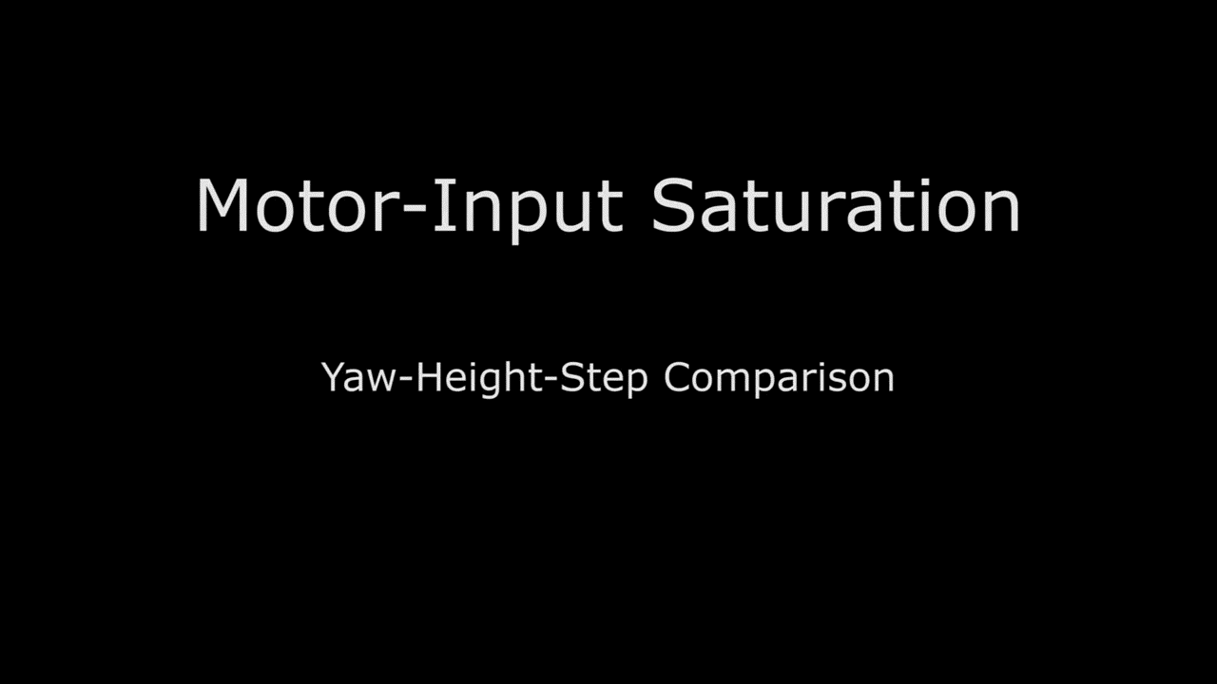
Prioritizing Motor Saturation

Slide 13
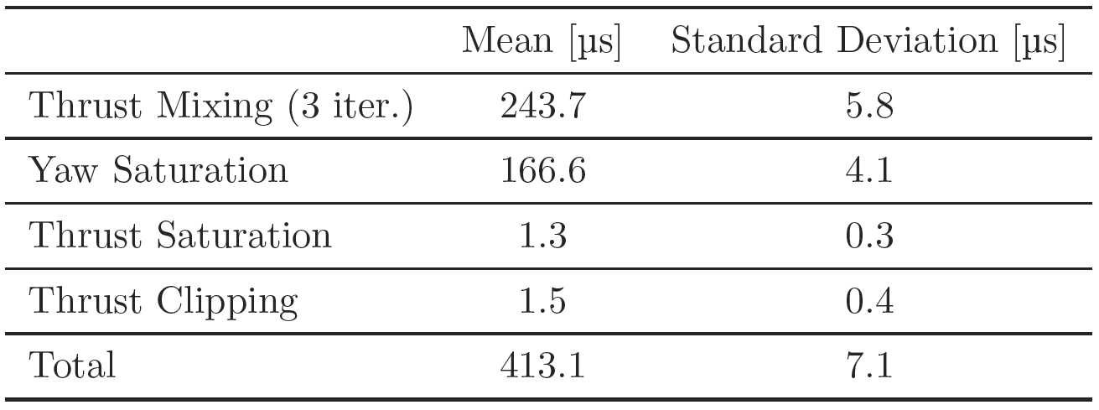
Computation Times

Slide 14

Video

