Slide 1
Software Quality FS 2012
Discussion Exercise 2
Eya Ben Charrada

Slide 2
SVN
structure
Using Trunk/Branches/Tags is a recommended practice
Trunk
Branches
Tags
Notes:
Best practice
In Svn, these folders should be created manually
Discuss the main properties for each one of them

Slide 3
Modularity
Extensibility
Testability
Notes:
Extensibility: - understandability is better when functionalities are separated
- extensions can be done by only modifying a low number of components
Testability: - difficult to address the input output of certain functions if these are combined with other functions

Slide 4
Improving the source code
Moving variables
Use CamelCase convention
Removing unreachable and dead code
Add brackets to if statements
Breaking long methods
Adding documentation
Rewrite more efficient code

Slide 5
JUnit
Only the first failure is reported by a test method.
public class MyTestCase {
@Test
public void testSomething() {
// Set up for the test, manipulating local variables assertTrue(condition1);
assertTrue(condition2);
}
}

Slide 6
JUnit
Only first failure reported in a test.
public class MyTestCase {
// Local variables become instance variables
@Before
public void setUp() {
// Set up for the test, manipulating instance variables
}
@Test
public void testCondition1() {
assertTrue(condition1);
}
@Test
public void testCondition2() {
assertTrue(condition2);
}
}

Slide 7
Testing strategies
Black-box:
Boundary values
Equivalence partitioning
white-box:
Coverage (branch, statement,…)

Slide 8
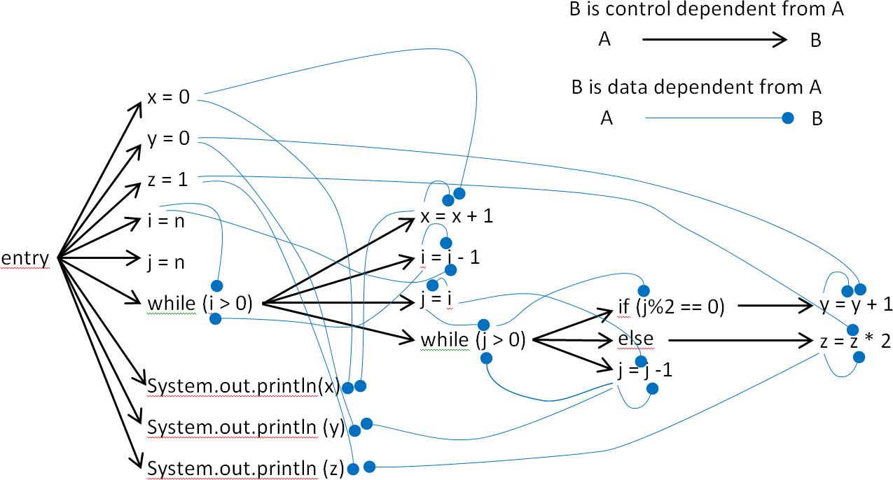
Dependencies
What’s wrong?

Slide 9
Dependencies
Slicing
Forward slice: Which parts may be affected?
Backward slice: A version of the original program with some parts missing, can be compiled and executed.
[Source: http://www.cs.ucl.ac.uk/staff/mharman/exe1.html]
Notes:
forward slicing : establish which parts of the program may have been
affected. Forward slicing can be used to assist a maintainer who has
located a bug (perhaps assisted by backward slicing) and now wishes to
modify the program to correct the bug. In so doing the maintainer also
wants to be sure that account is taken of the ripple effects of the
change. To illustrate this approach to maintenance, consider the
example program fragment in Figure 7.
backward slicing: A backward slice – simply a version of the original
program with some parts missing – can be compiled and executed. An
important property of any backward slice is that it preserves the
effect of the original program on the variable chosen at the selected
point of interest within the program.

Slide 10
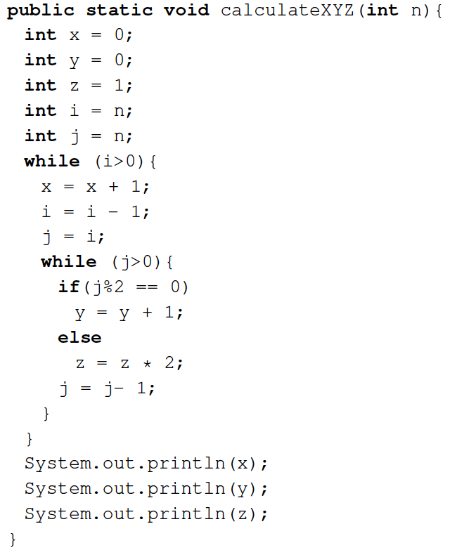
Dependencies
Slicing
Notes:
forward slicing : establish which parts of the program may have been
affected. Forward slicing can be used to assist a maintainer who has
located a bug (perhaps assisted by backward slicing) and now wishes to
modify the program to correct the bug. In so doing the maintainer also
wants to be sure that account is taken of the ripple effects of the
change. To illustrate this approach to maintenance, consider the
example program fragment in Figure 7.
backward slicing: A backward slice – simply a version of the original
program with some parts missing – can be compiled and executed. An
important property of any backward slice is that it preserves the
effect of the original program on the variable chosen at the selected
point of interest within the program.

Slide 11
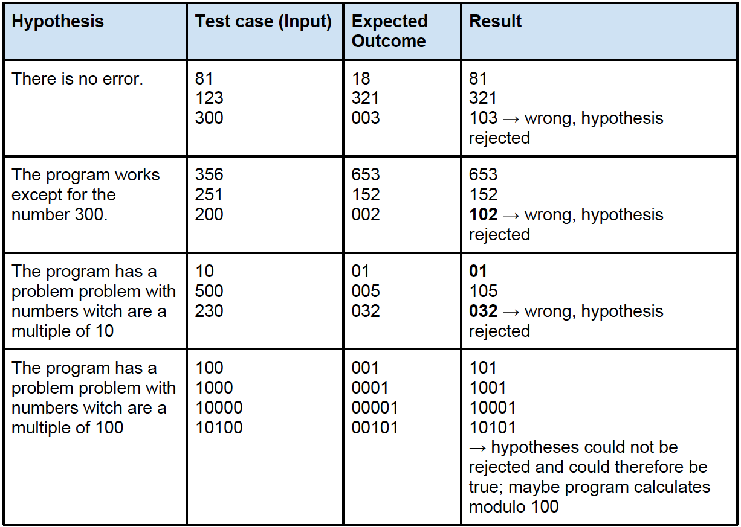
Hypothesizing about a defect

