Slide 1
Software Quality FS 2012
Exercise 2 - Introduction
Eya Ben Charrada

Slide 2
Exercise 2
ImageJ (check out from repository, building, improving, testing)
Static Analysis
Defects

Slide 3
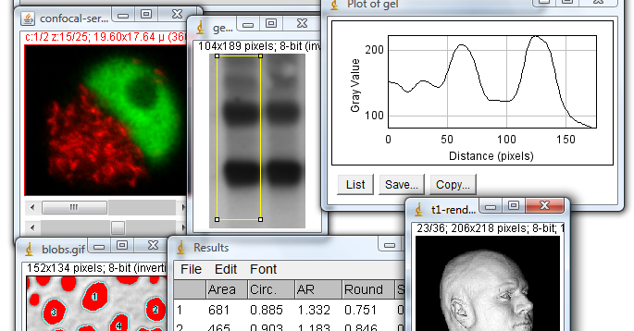
Exercise 2
ImageJ

Slide 4
Exercise 2
Daiquiri
Trac:
http://daiquiri.ifi.uzh.ch/trac/swq12/
SVN:
https://daiquiri.ifi.uzh.ch/svnswq12/
Hudson:
http://daiquiri.ifi.uzh.ch/hudson/job/SwQ_FS_12/

Slide 5
Exercise 2
Daiquiri - Registration
Register on trac with sxxyyyzz as username and ask for access to svn (as early as possible)
http://daiquiri.ifi.uzh.ch/trac/swq12/

