Slide 1
Open Government data initiative
Open innovation and The Cloud
Nov 2011 - Zurich
Mark Gayler – magayler@microsoft.com
Open Software Evangelist
Microsoft Corp

Slide 2
Agenda
What is Open Data?
Open Data around the World
Examples of Open Innovation
Open Government and The Cloud
Q&A
Notes:
This presentation focuses on examples from different Government agencies that have developed open data applications and services and discusses and how these projects drove innovative outcomes.

Slide 3
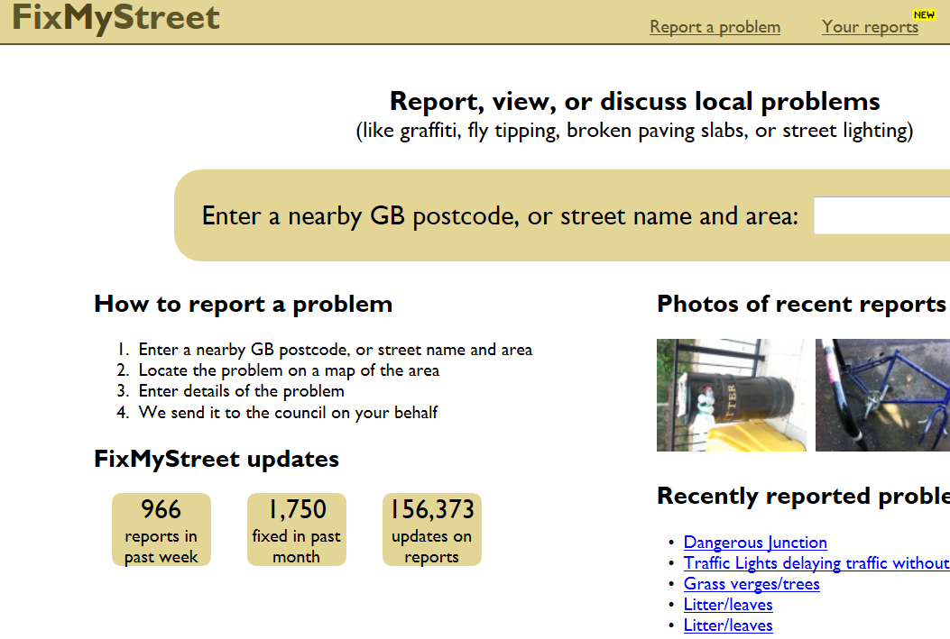
Open Data - Applications
Developed by Public
  ‘Community’ developers
  Local citizens
Often called ‘Mash-Ups’
  Typically utilize GIS mapping
  Often use GPS and mobile
Often utilize ‘crowdsourcing’
Open data protocols
  E.g. KML, XML, RSS
Often ‘free’, OSS and ‘open’ toolsets...
  PHP, MySQL, MediaWiki, Python etc.
Notes:
FixMyStreet from MySociety.org in UK is one of the earliest examples of open data applications.

Slide 4
Apps for Democracy
http://www.appsfordemocracy.org
“The first edition of Apps for Democracy yielded 47 web, iPhone and Facebook apps in 30 days - a $2,300,000 value to Washington DC at a cost of $50,000”

Slide 5
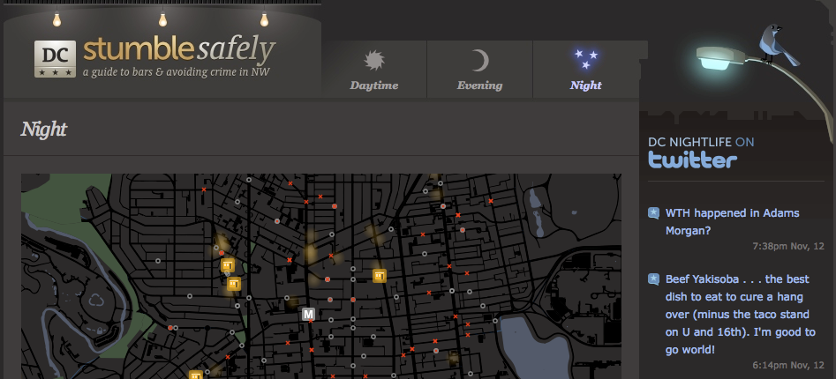
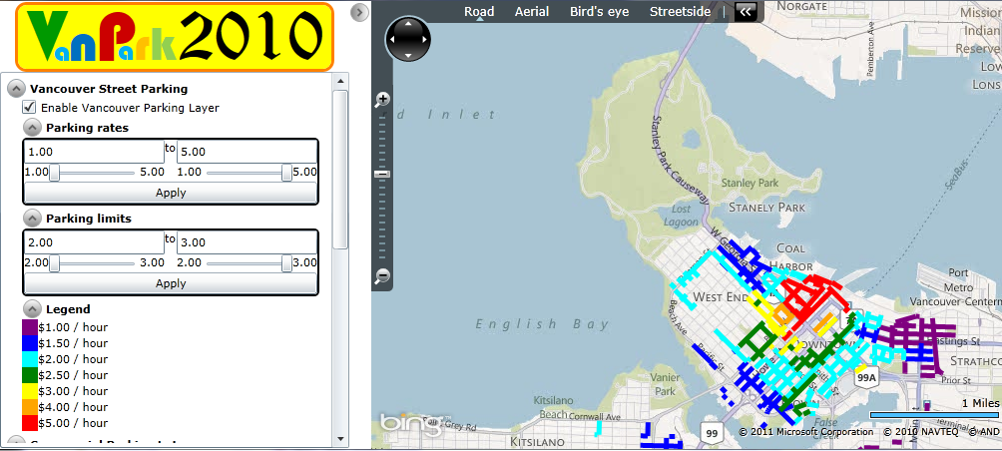
Open Data Apps - Mobile
Data on the go
Timeliness
Location relevance
Mobility
Social Networking
Washington DC - Stumble Safely
Vancouver Parking 2010
  Parking mashup for
  2010 Winter Olympics
Notes:
Stumble Safely combined near-realtime crime data with transit routes and location of bars and restaurants. It’s purpose was to highlight crime hotspots that citizens could avoid on the way home at night.
VanPark2010 was built for the Vancouver Winter Olympics as a central portal providing City parking AND commercial parking data in one app. Prior to this, a citizen or visitor to the City may have to go to 3 different websites to see parking information.

Slide 6
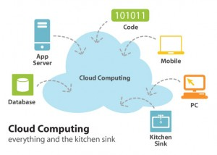
Open Data and The Cloud
Cloud inherently ‘open’ – supports open toolsets
Device independence
Minimal infrastructure impact
Low entry cost
Fast ‘time-to-market’
Scalable – based on
demand
*Graphic courtesy techlabs.com

Slide 7













Windows Azure Platform
  Developer Experience
  Use existing skills and tools.
Windows Azure
Command-line Tool for
Tools for Windows Azure
Windows Azure
SDKs
AppFabric SDKs
http://
oData
XML
AtomPub
REST
RSS
Web Services
Runtimes &
Services
Notes:
Windows Azure is inherently designed to be ‘open’. Developers can continue to use their existing tools whether they are using .Net, ASP, PHP, Ruby, Python, etc.

Slide 8

Open Government Data Initiative
Open Government Data Initiative (OGDI)
Cloud Computing Application
  Runs on Windows Azure
OGDI Data Site - http://ogdisdk.cloudapp.net/
Open Application
  OGDI Source code is free, open source and customizable with ‘Starter Kit’ via www.codeplex.com
  Can be used to publish data on the Internet in a Web-friendly format with easy-to-use, open API's.
  API’s can be accessed from Silverlight, Flash, JavaScript, PHP, Python, Ruby, mapping web sites, etc.
Windows Azure Services Platform - will carry storage and transaction charges depending on usage
Notes:
OGDI is a free and open source solution enabling Governments to easily publish data to the Cloud for ubiquitous access by citizens and developers.
Considering Tim Berners-Lee ‘5-stars of Open Data’ – OGDI gives you 4-stars ‘out-of-the-box’.

Slide 9
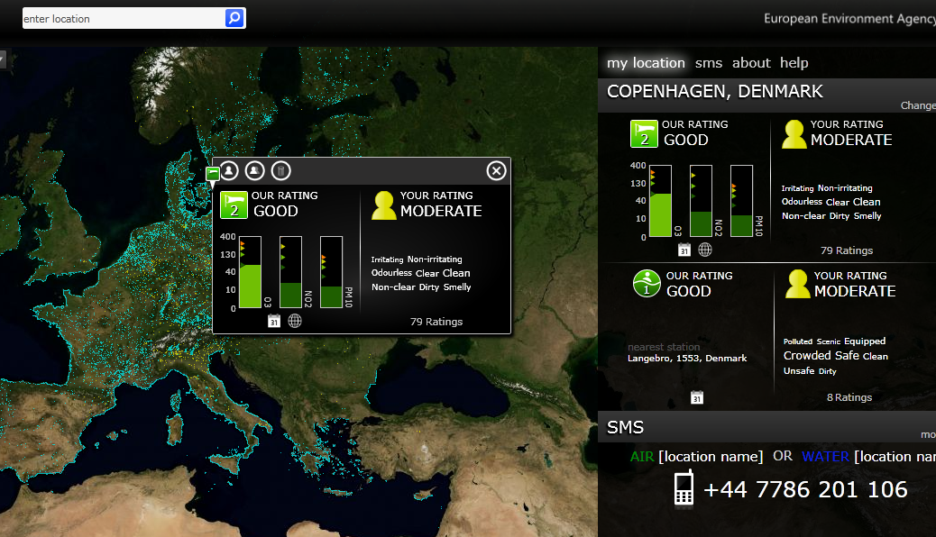
EU Eye on Earth
http://www.eyeonearth.eu/
Global observatory for environmental factors
  Air and Water Quality
Combines Gov statistics with public feedback
Interactive, 2-way communications with ratings
V3 with OpenAPI
Notes:
Eye on Earth plots thousands of data points across Europe enabling citizens to rate the quality of Air and Water in different locations via SMS (and compare with Government data), demonstrating the large scale capability of the Cloud.

Slide 10
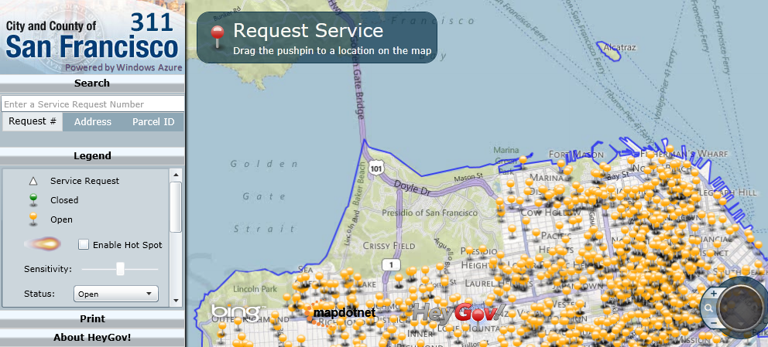
City of San Francisco – Open311
San Francisco 311
Allows citizens to report and track non-emergency incidents
Combines mapping with Cloud
Notes:
San Francisco ports the updates from its 311 call centre to the Cloud enabling citizens easy access to the latest information without burdening the call centre. A good example of a ‘hybrid’ approach. Operational 311 system combined with Cloud back-end.

Slide 11
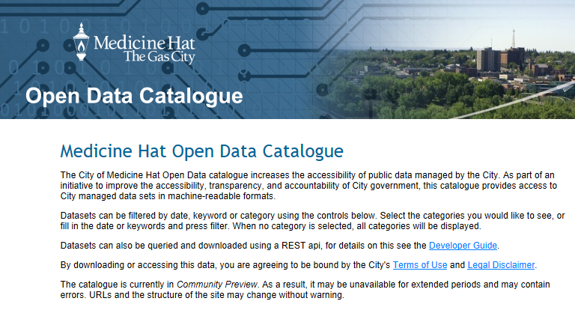
Medicine Hat – Open Data Catalog
Utilizes OGDI/Azure
Property Assessments
Elections
Buildings
Very small scale
Notes:
City of Medicine Hat are small City in Western Canada. They built an open data portal using OGDI/Azure in ‘a few days’ demonstrating the small scale and low-cost features of the Cloud.

Slide 12
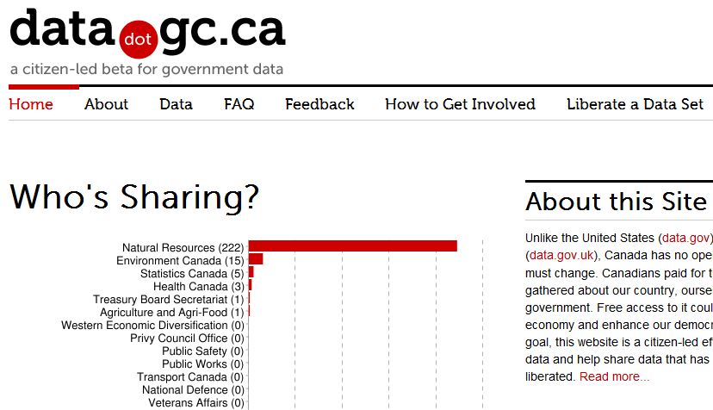
datadotgc.ca
CDN Federal open government data
OGDI/Azure data storage
Drupal front-end
CKAN
Notes:
Uses a ‘hybrid’ approach. Drupal front-end, CKAN for data publishing, and OGDI/Azure for Cloud-based data storage and Open API.
Good example of Cloud being used with open source technologies.

Slide 13
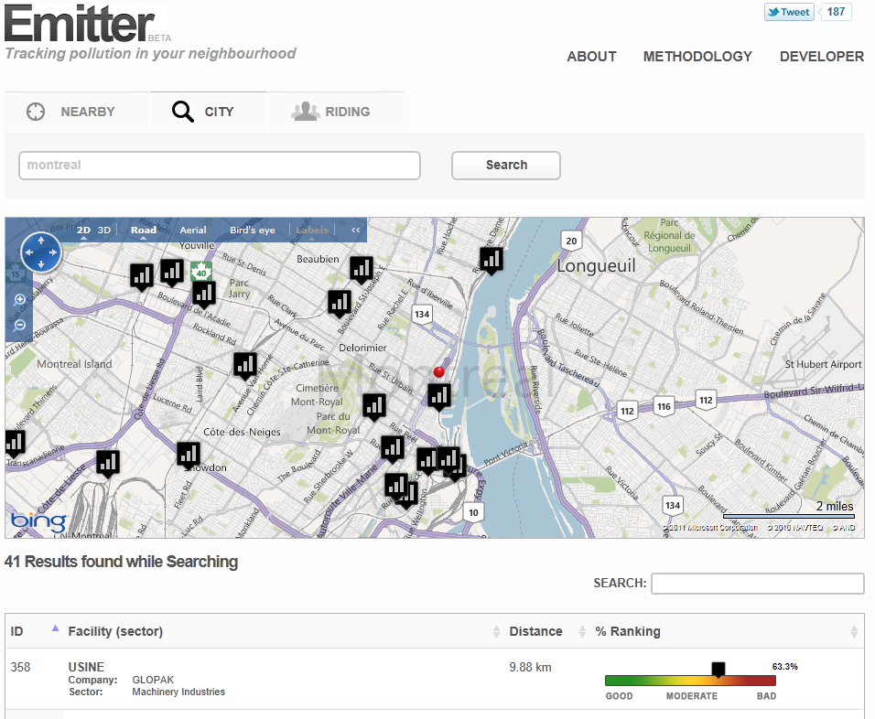
Emitter
Tracks Pollution sources in local neighbourhood
OGDI/Azure data storage
Drupal front-end
Open Source
on Github

Slide 14
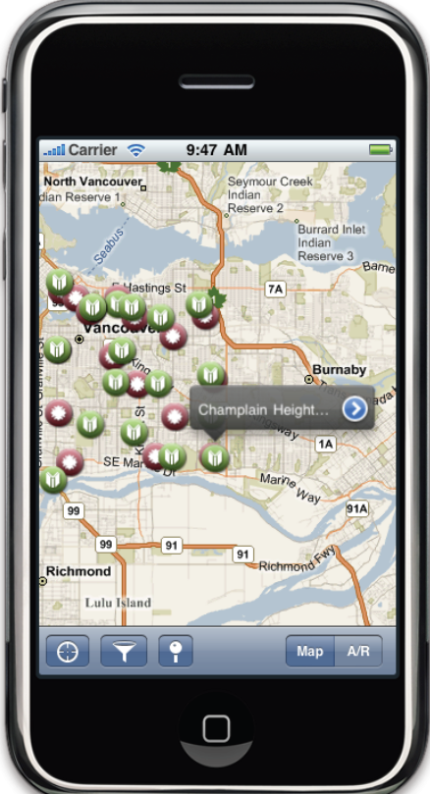
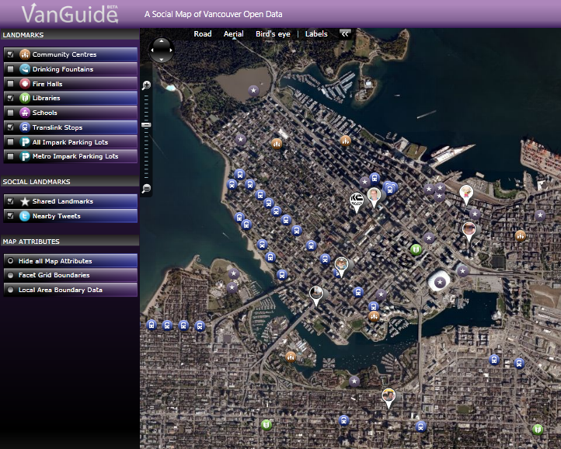
Vancouver - VanGuide
Incorporates Cloud, mapping,
social networking, iPhone, WP7
ODAF
Open Source
on Codeplex
Notes:
VanGuide – built for visitors during the 2010 Winter Olympics. One of the first open data applications to combine City open data with transit routes AND Twitter social media integration. Based on Windows Azure cloud with both iPhone and Windows Phone mobile clients.

Slide 15
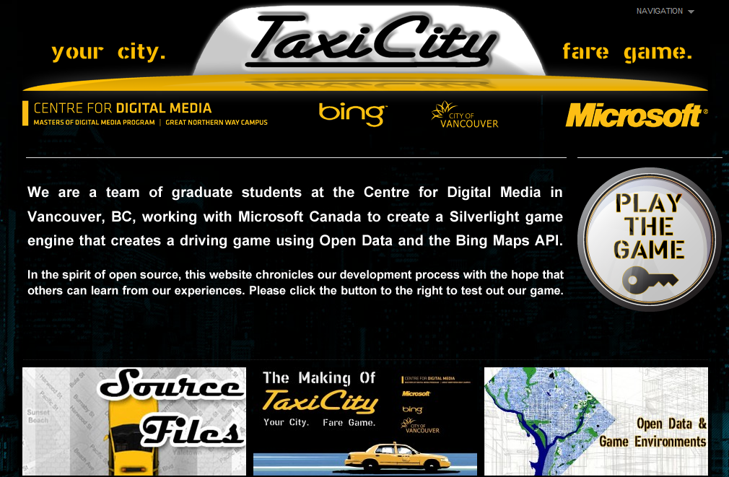
Vancouver – Taxicity Game
Notes:
TaxiCity. Built by the Centre for Digital Media in Vancouver. The students built a virtual game for tourists using Vancouver open data and Cloud as an example of what can be done in digital media space with open data.

Slide 16
Benefits of Open Data and Cloud
Inherent support for open standards
Ability to share/reuse code
Minimal infrastructure investment
Low-cost of data storage
Highly scalable based on datasets+usage
  Popularity drives transactions
Avoids ‘silos’ of data catalogs
One app can be used by multiple jurisdictions
  E.g. http://emitter.ca, Open311

Slide 17
Driving Innovation
Join Government + Citizens + Developers
  Opportunities for innovative new apps and services
  Possibilities to monetize – for EE and EU
Exploit Cloud Computing
  Do it better, faster, sexier than the rest!
Free or Not Free? – Do BOTH!
Ensure you have scalable infrastructure
  Government + Commercial data (SLA)
  E.g. weather, environment, traffic, transport

Slide 18
5 Stars of Open Data*
* Star for putting data on the Web at all, with an open license. E.g. Zip files and PDFs get 1 star.
** Stars if it's machine-readable e.g. Excel.
*** Stars for machine-readable, non-proprietary formats e.g. CSV or XML.
**** Stars if the data uses URL for identification.
***** Stars when data is linked to other data for context.
*Tim Berners-Lee – Gov 2.0 Expo, 2010

Slide 19
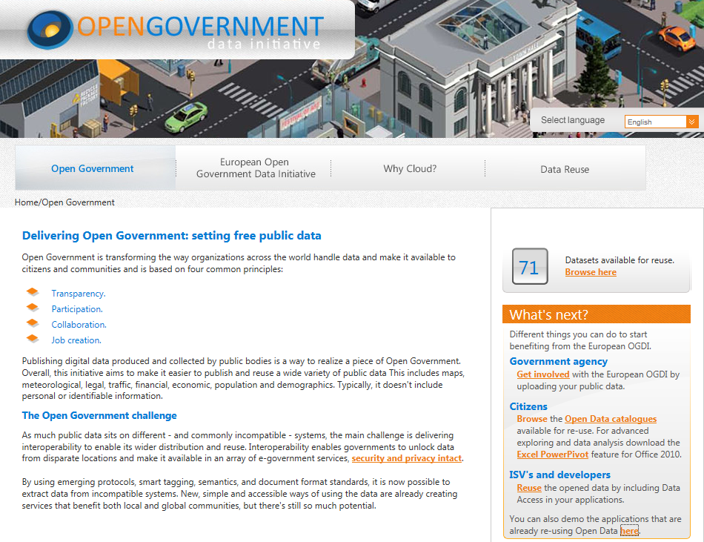
Open Data in EU
http://govdata.eu
70+ datasets
Dozen application
demos
Notes:
Open Government Cloud-based sandbox site for EU. Government agencies can load their data into the Cloud and make it available to citizens and developers via an Open API. Currently hosts data from over 20 countries and more than 90 datasets.

Slide 20
Open Data Resources
OGDI Interactive SDK – http://ogdisdk.cloudapp.net
OGDI on Codeplex – http://ogdi.codeplex.com
VanGuide on Codeplex – http://vanguide.codeplex.com
Open Data Application Framework – http://odaf.codeplex.com
VanGuide and ODAF on YouTube - http://www.youtube.com/watch?v=bZUHVQT24Is
OpenIntel on Codeplex – http://oi.codeplex.com
Emitter on Github – http://github.com/redbit/emitter
Port 25 – http://port25.technet.com

Slide 21
Q&A

